Slide 1
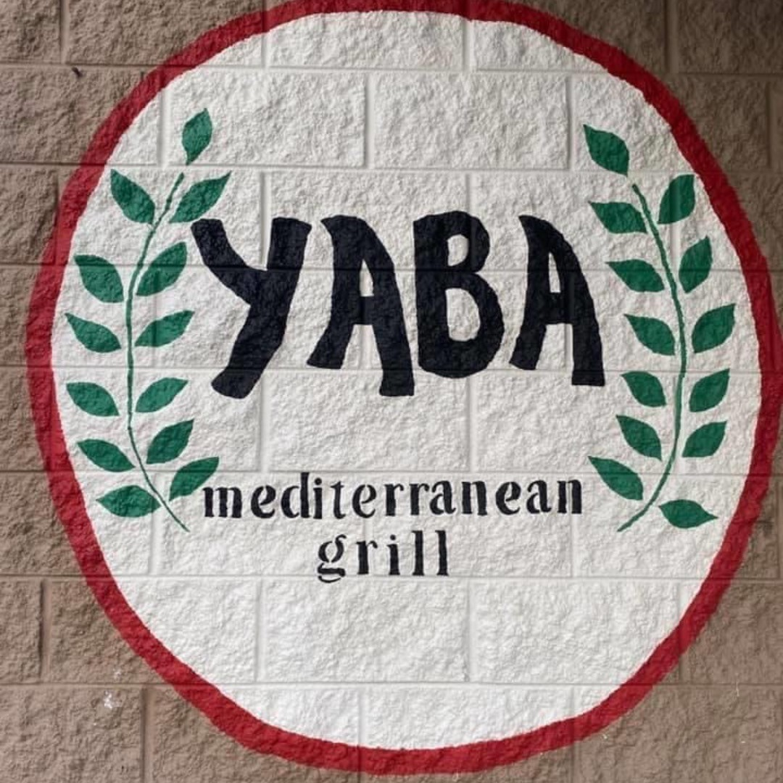
Yaba Mediterranean Grill
Sprint 1
Team 3
By: Liam Alexander, Sabrina Knott, Alex Waller, and Karrington Evans

Slide 2
Business description and brief history
Yaba is a family-owned restaurant that serves Mediterranean food at an affordable price in Greenville, North Carolina.
It was established in 2020 and is located at 1201 Charles Blvd, Greenville, NC 27858.
Majd Thaher is the owner in Greenville, North Carolina and is a current student studying public health.
The success of Yaba in Greenville has allowed for the family to quickly open another location in Raleigh this past year.
Yaba’s mission statement is to bring authentic shawarma and Mediterranean cuisine, from their homeland Palestine, to North Carolina as a healthier restaurant option. They have a promise to prepare healthy and delicious food, all while maintaining the bold flavors of Middle Eastern cuisine in an atmosphere that is clean and welcoming to all.

Slide 3
Current Environment
Yaba’s current environment involves two restaurants in different locations with menus differing mainly in price.
Customers currently order on Yaba’s website, choose what they want, and the location selection is only for Greenville currently.
Orders come through on an app called square restaurants and then are automatically sent to their Wireless Bluetooth printer.
There’s recently been a lot of confusion on the Yaba website due to the new location. Customers in Raleigh will place an order on the website but don’t realize they’re sending orders to Greenville. Furthermore, that order in Greenville goes to waste. This has made customers unhappy, caused unnecessary stress for current workers, and is hurting the Yaba’s potential revenue.
Majd has emphasized that customer feedback has asked for an account option on Yaba’s website to be made instead of the newsletter!

Slide 4
Why did we choose this project?
Our team decided on this project because we’re under the impression Yaba will implement our system. They’re a small family-owned business, and they’re not the most technically sound. We all felt like our efforts over the coming weeks should be put to work for a business that will use it. The current owner allows for an open line of communication throughout the day which makes it very easy for us to access whatever we need. The last incentive comes in the form of free food from Yaba for our help!

Slide 5
Problems observed with the current system
Can’t order from more than one location
Doesn’t display the different menus between locations
Lack of customer account option
Confusion for customers and workers with two locations and only one place to order now

Slide 6
Proposed system objectives and constraints
The system our team is proposing for Yaba is an additional location option with a menu that has the corresponding prices for the Raleigh location on their website. This will allow the customers of Raleigh to be able to order online and eliminate any customer confusion in the future for this location.
This system will also provide a customer login on the website. Having this feature on the website will allow every customer who creates a login on the website to have their information saved to make ordering online more efficient. Business will also run more smoothly by already having recurrent customer information in the database.
The most crucial constraint for this project is time. The owner of Yaba, Majd, has requested for this system to be ready as soon as possible. The website will be down temporarily as we implement the new system. The timing limits the scope of the project because the scope also must be rational for the system to be done as soon as possible.
System objective
System constraint

Slide 7

Expected Benefits
Minimize calls to restaurant
More customer traffic and awareness (improving sales during COVID)
Accurate menu prices for both locations
Increased Revenue

Slide 8
Problems Analysis
Our team will be improving the business processes at Yaba for a BPI project. We believe we’re improving effectiveness and optimizing their performance with the improved ordering system.

Slide 9
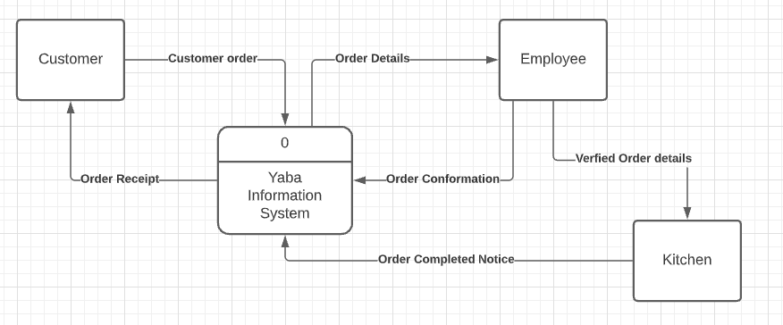
Context Diagram

Slide 10
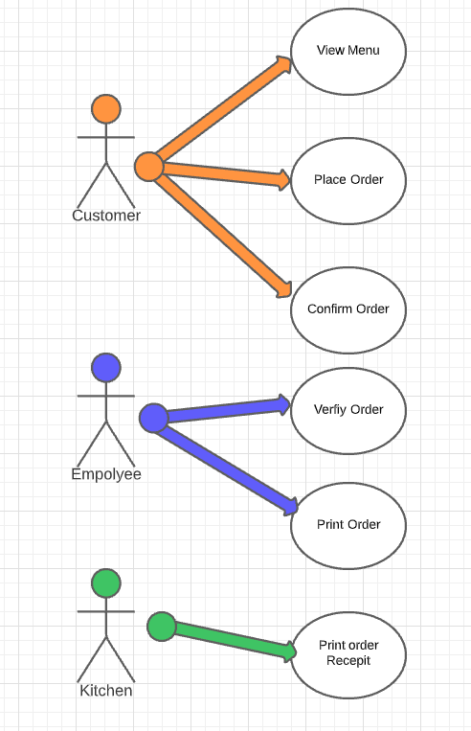
Use case Diagram

Slide 11
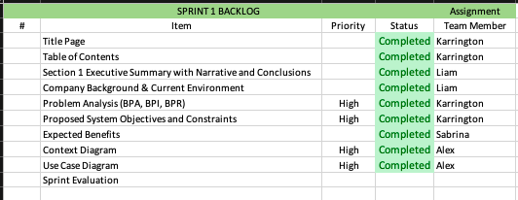
Sprint 1 Backlog

Slide 12
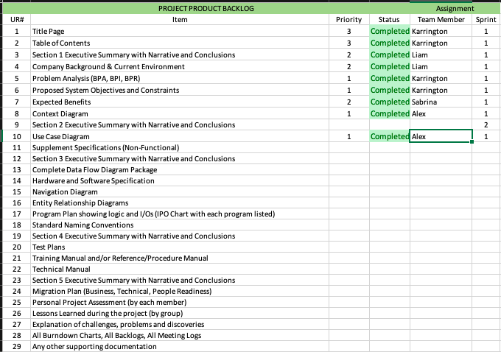
Sprint 1 Product Backlog

Slide 13
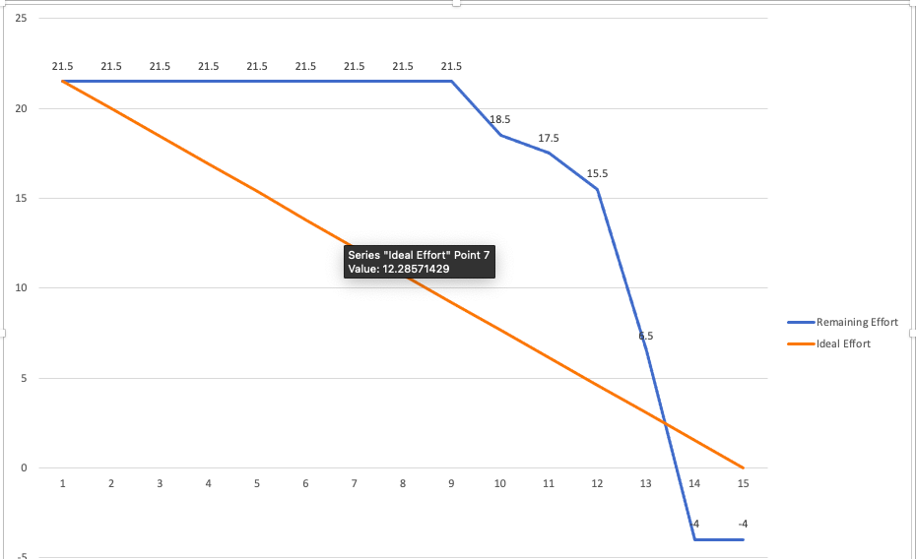
Sprint 1 Burndown Chart

Slide 14
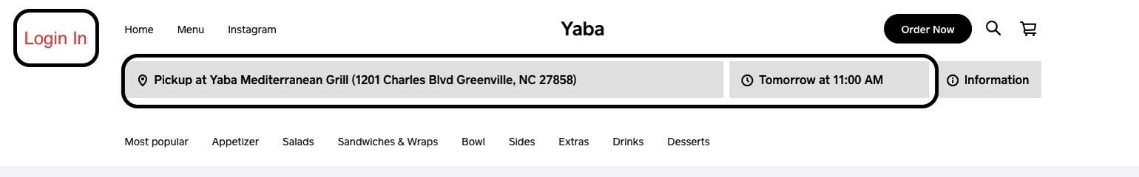
Potential Shippable Product Increment

